Slide 1
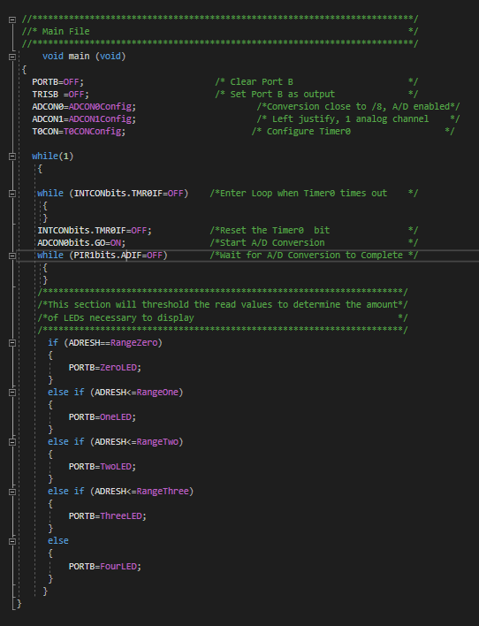
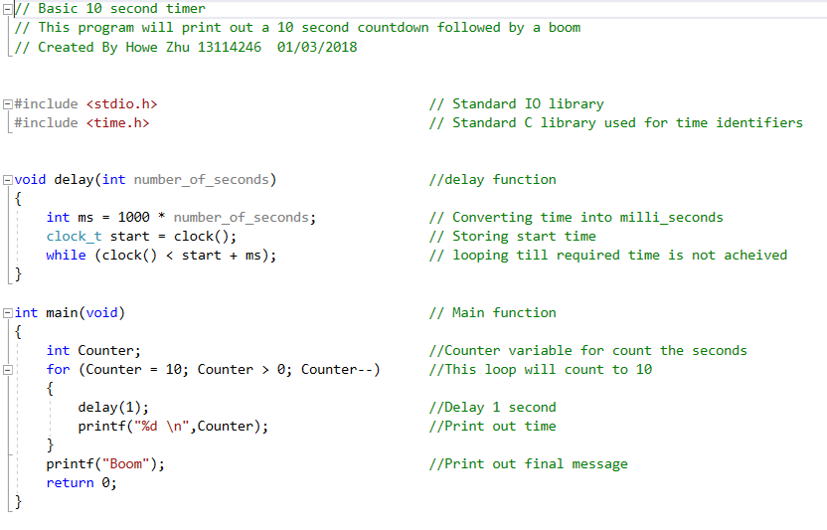
Embedded C
Week 1
Week 2-12?
C/Basic C
Embedded C

Slide 2
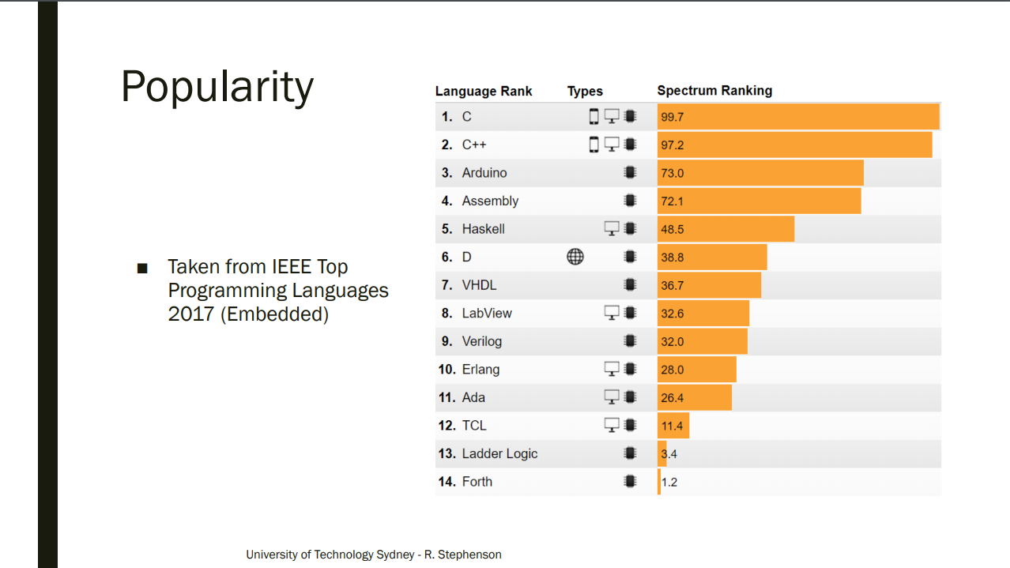

Slide 3
Embedded C
C/Basic C and Embedded C mostly the same in syntax and structure of code. Many consider Embedded C an extension of the C language.
However, there are subtle differences:
C is a general purpose programming language, while Embedded C focuses on microprocessor and embedded systems.
Embedded C often interacts with fixed point numbers, I/O ports, and registers.

Slide 4
Arduino IDE
https://www.arduino.cc/en/Main/Software
You have two options
Use the web based editor
Download and install the local Arduino IDE

Slide 5
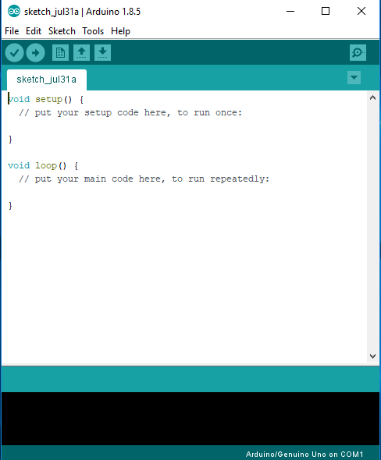
IDE- Installed IDE
Load code to board
Serial Monitor
Test Build Code
Source Code editor
Compiler output

Slide 6
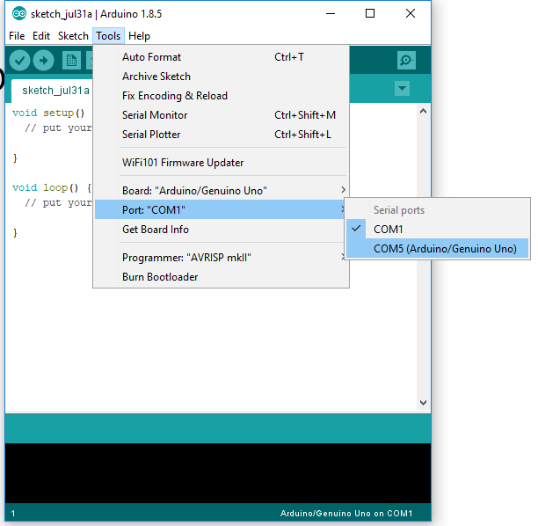
IDE- Select Board settings
Select tools -> Board select “Arduino/Genuino UNO”-> Port select the one with the Arduino

Slide 7
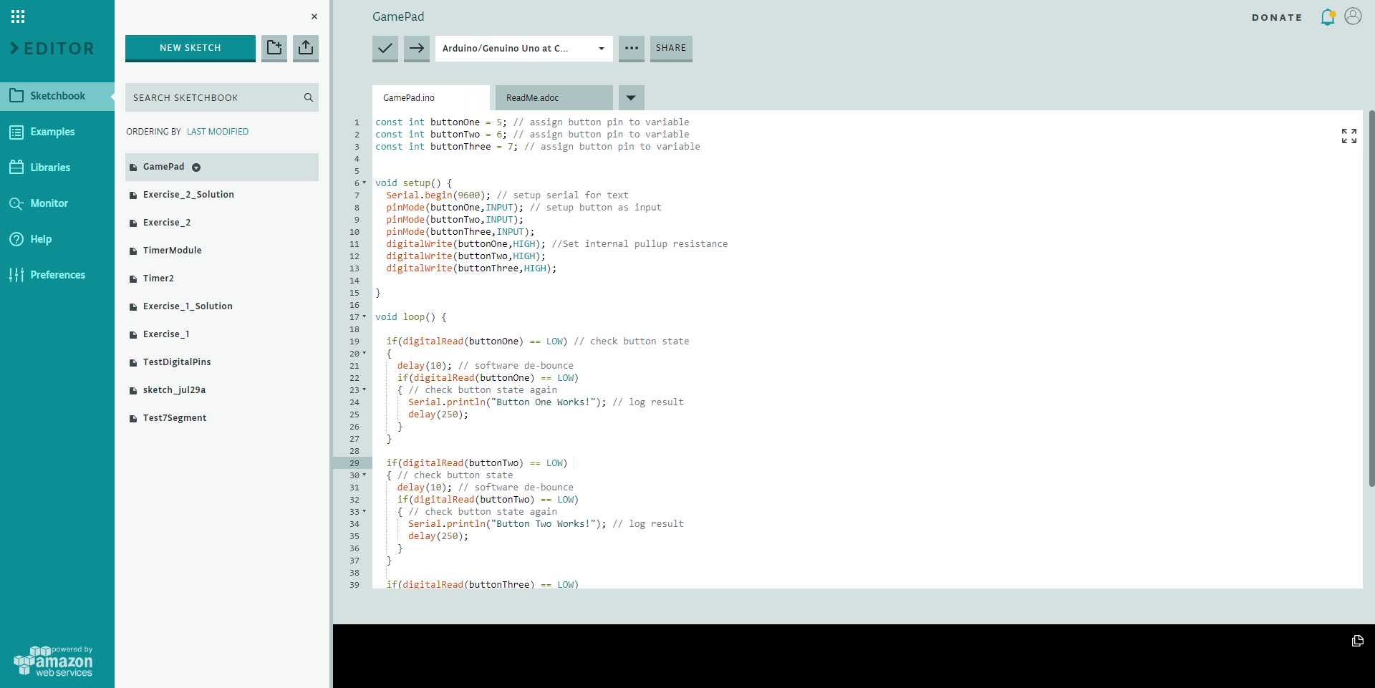
IDE- Web Editor
Load code to board
Select Board Use this to load the board
Test Build Code
Source Code editor
Serial Monitor
Compiler output
Library

Slide 8
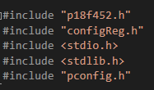
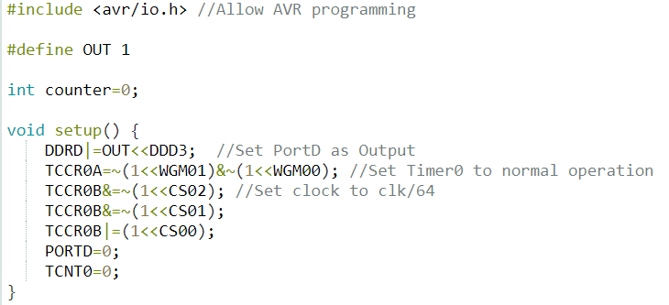
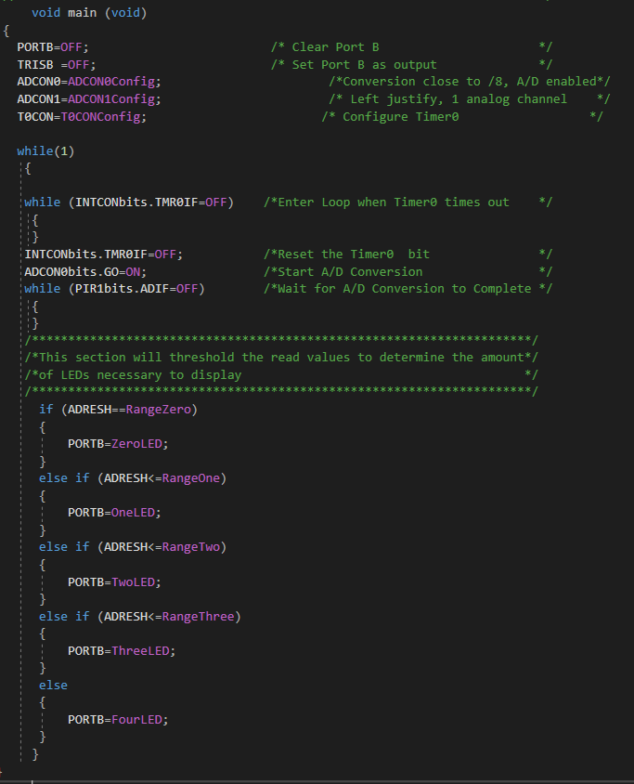
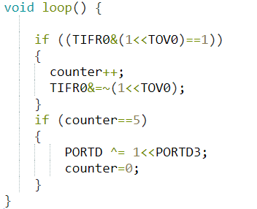
Basic Structure of Embedded C
Always include this for this course
Include Headers
Setup
Main Loop

Slide 9


Arduino but not Arduino
For assignment 2, you will not be allowed to use the standard Arduino functions.
Using them will incur penalties apply.
Refer to the ban list on UTS online for prohibited functions.
Assignment 3 you can use whatever you like ☺

Slide 10
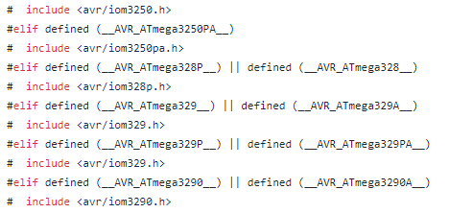
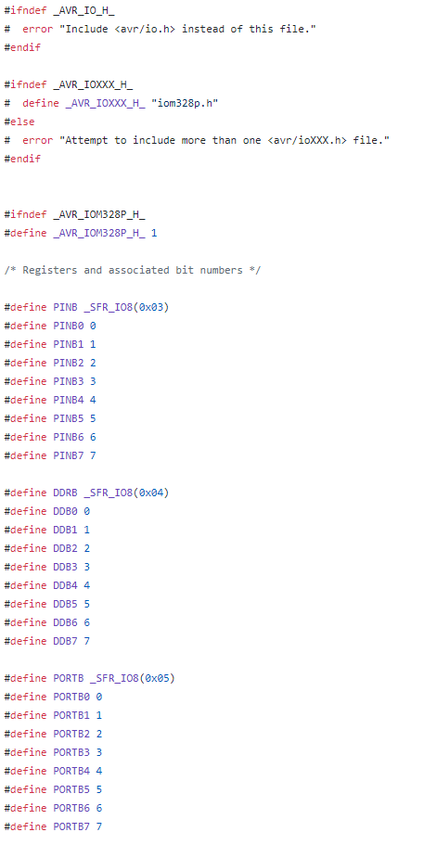
AVR Programming
Arduinos are conventionally programming with the C++ Arduino language library.
However, it is possible to use C to directly program the microprocessor ATmega328P.
The <avr/io.h> header file will need to be included to define the addresses of the registers and ports on the microprocessor.
https://github.com/vancegroup-mirrors/avr-libc/blob/master/avr-libc/include/avr/iom328p.h
https://github.com/vancegroup-mirrors/avr-libc/blob/master/avr-libc/include/avr/io.h

Slide 11
Setup steps
Determine what operation you want to use:
I/O Ports: Often used to control actuators and other hardware. Can also be used to receive inputs.
Timers: Mainly used for timing and setting operations to a certain frequency.
Analog to Digital Conversion: Mainly used for sensor interfaces.
Serial (SPI, USART, UART, and TWI): Typically used for communications with other devices.
Read datasheet to learn the operation and determine the relevant registers to set.
Set registers to the desired operations.

Slide 12
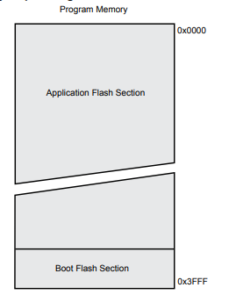
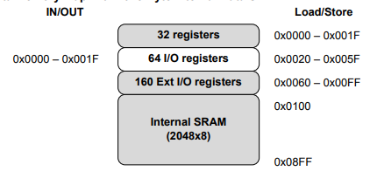
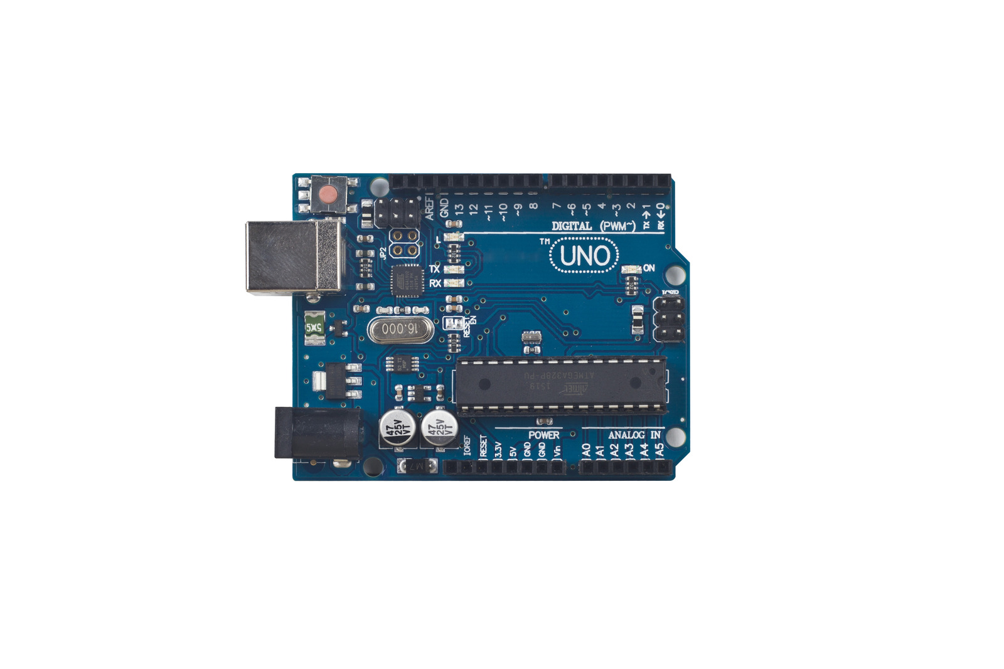
Configuring Registers
Registers are a storage variable that is 8 bit in size with some 16 bit values separated into two 8 bit registers.
Not all register bits are writable. Refer to datasheet on the roles of specific bits in a register.
Due to the way avr/io.h is structured, you cannot directly set the register bits (unlike the MXK pic18).

Slide 13
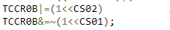
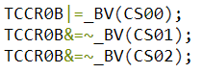
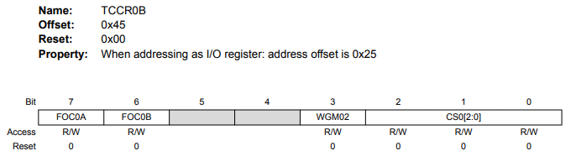
Configuring Registers-Set register bits
Directly setting the register byte (8 bits)
Using bitwise operations for the specific bit
Macro_BV
Toggle Bit on with OR operator
Toggle Bit off with inverse AND operator
Toggle Bit on
Toggle Bit off

Slide 14

Timer Module
Timers are essentially counters that fills at a certain clock frequency
8 Bit Timers is 0x00-0xff or 0-255, 16 Bit is 0x0000-0xffff or 0-65536
Timer prescaler intentionally lowers the clock frequency through by an integer division (ClockFrequency/Prescaler).
Clock Period=1/Frequency
No Prescaler
Clk/8 Prescaler
Clk/64 Prescaler
Clk/256 Prescaler
Clk/1024 Prescaler
Speed not to scale

Slide 15
Timer0
Timer0 will always behave abnormally compared to Timer1 and Timer2.
This is due to the Delay() function in the Arduino library.
https://code.google.com/archive/p/arduino/wikis/HardwareResourceMap.wiki
Timer2 functions exactly the same as Timer0.
You should familiarise yourself with using the interrupt vectors for the Timers.

Slide 16
General Tips

Slide 17
Debugging in Arduino IDE
The Arduino IDE does not support breakpoints, this means that you will need another way to check if the program has gone through certain lines of code.
The serial() Arduino functions will allow you to print checkpoints in your code after certain lines. These can act as checkpoints for you to debug with.
https://www.arduino.cc/en/pmwiki.php?n=Reference/Serial
https://www.arduino.cc/reference/en/language/functions/communication/serial/print/
https://www.arduino.cc/reference/en/language/functions/communication/serial/begin/

Slide 18
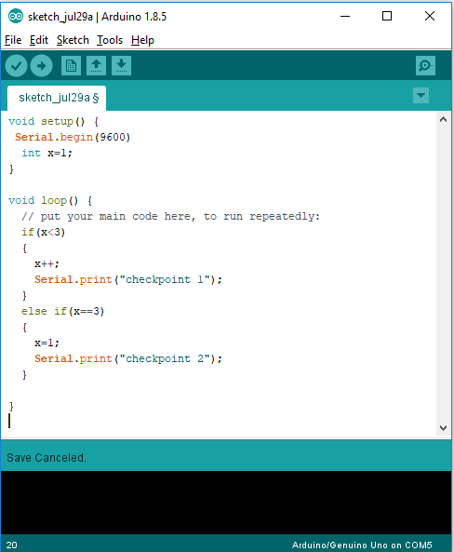
Serial Monitor

Slide 19

Datasheets
Datasheets are documents provided by the manufacturer of the component and it is aimed to help you understand the provide component.
The ATMega328 data will be the main data you will be using to understand how to program the microcontroller.
In the following weeks you will be referring to many other datasheets.

Slide 20
Atmega328 Data Sheets
ATMEL Version of the Datasheet: http://ww1.microchip.com/downloads/en/DeviceDoc/Atmel-42735-8-bit-AVR-Microcontroller-ATmega328-328P_Summary.pdf
Microchip Version (they scrapped the datasheet version I liked ☹) http://ww1.microchip.com/downloads/en/DeviceDoc/ATmega48A-PA-88A-PA-168A-PA-328-P-DS-DS40002061A.pdf
I’ve uploaded the older version of the ATmega328 datasheet on UTSOnline

Slide 21
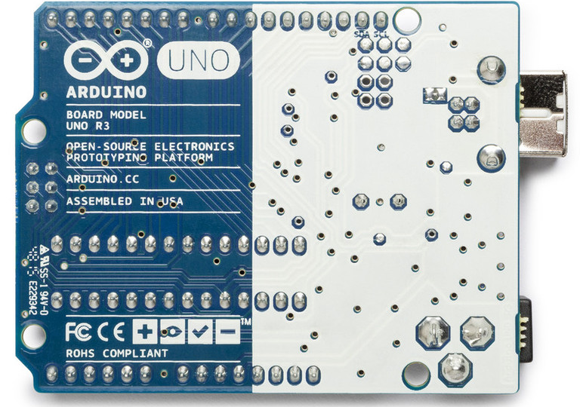
Take care of the board
https://www.rugged-circuits.com/10-ways-to-destroy-an-arduino/
Don’t place your boards on metal surfaces as the bottom side will short.
Do not connect the Vin/5v to GND as this will short the board.
A faulty board won’t necessarily be unprogrammable, but they might behave weirdly. When in doubt test your code on another board.
If it works, then the board is faulty.
If it doesn’t work, then your code is faulty.

Slide 22
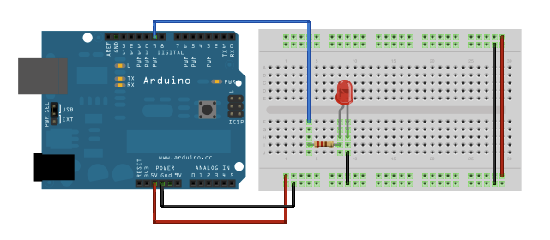
Examples- Turning on an Digital I/O Port
We need to write a program turns this LED on when the Arduino is powered on.

Slide 23
Examples- Turning on an Digital I/O Port
We know that the LED is connected to Digital Pin 9 on the Arduino board.
We also know that the Digital Pin when set to on will output 5v to turn the LED on.

Slide 24
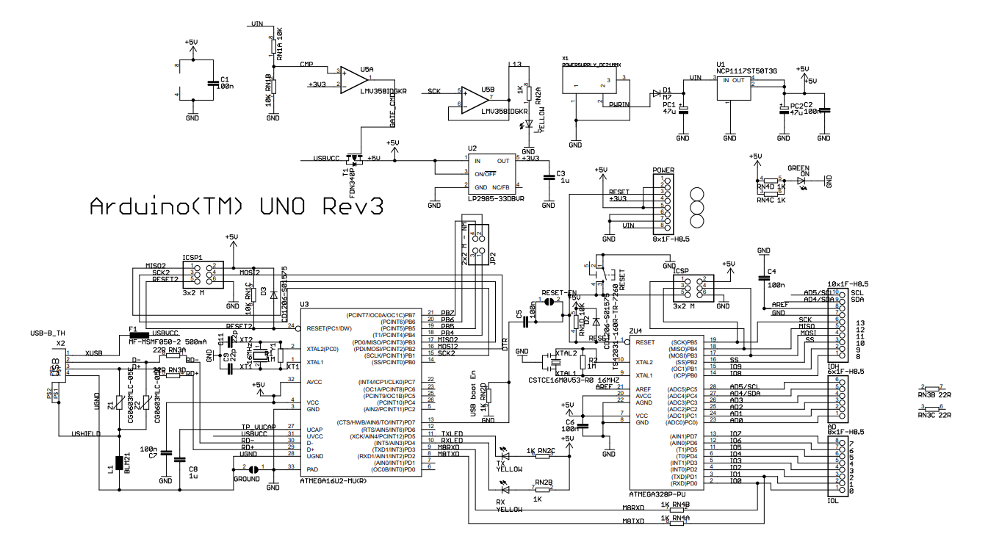
Examples- Turning on an Digital I/O Port
We need to turn on Digital Pin 9.

Slide 25
Examples- Turning on an Digital I/O Port
It is connected to Port B pin 1 on the ATMega328.

Slide 26
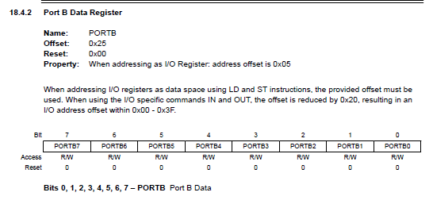
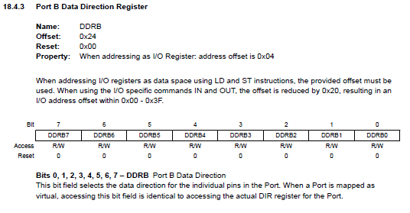
Examples- Turning on an Digital I/O Port
We need to turn on PortB Pin 1. To do this we need to look at the datasheet. (Chapter 18 IO Ports). PortB registers are at 18.4.2 and 18.4.3

Slide 27
Examples- Turning on an Digital I/O Port
According to the Datasheet:
The Port B pin 1 Data Direction needs to be set as Output (set DDRB1 to 1)
The Port B pin 1 register bit will need to be set to high (set PORTB1 to 1)

Slide 28
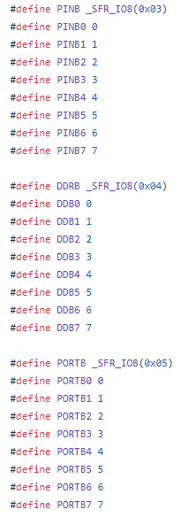
Examples- Turning on an Digital I/O Port
Program:
Setup: Set DDRB1 to 1
Loop: Set PORTB1 to 1
What are DDRB1 and PORTB1 register address and name?
Lets check the avr/iom328 header file
DDRB1 is called by the register DDRB and variable DDB1
PORTB1 is call by the register PORTB and variable PORTB1 ☺
https://github.com/vancegroup-mirrors/avr-libc/blob/master/avr-libc/include/avr/iom328p.h

Slide 29
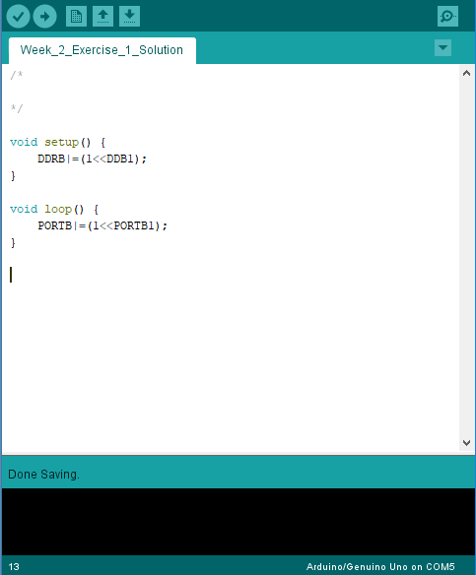
Examples- Turning on an Digital I/O Port
*Bling ☺*

Slide 30
Example Setting Up a timer
Now that you have gotten the LED working, you need to make the LED turn off or on every 250ms (4Hz).

Slide 31
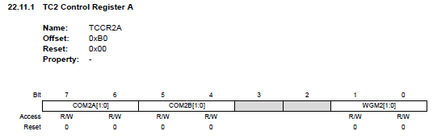
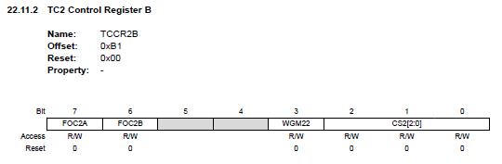
Example Setting Up a timer – setup()
To do this we will need the Timer modules. Lets use Timer 2, an 8 bit timer module (Chapter 22).
Lets set up the timer first:
We will need to set up Control Register A & B (TCCR2A & TCCR2B)

Slide 32
Example Setting Up a timer – setup()
We want the Timer to be in normal operations
And have a prescale value of 256.

Slide 33
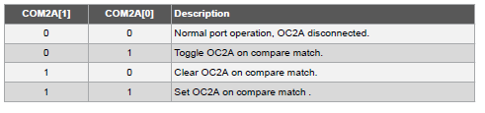
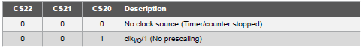
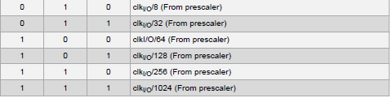
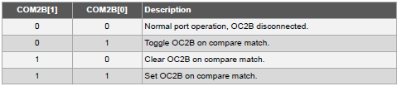
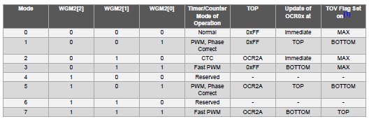

Slide 34
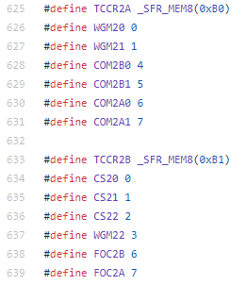
Example Setting Up a timer – setup()
From the Datasheet it looks like I need to set:
TCCR2A Register – Normal Operation
WGM20=0
WGM21=0
COM2B0=0
COM2B1=0
COM2A0=0
COM2A1=0
TCCR2B – Prescale 256
CS20=0
CS21=1
CS22=1
…..

Slide 35
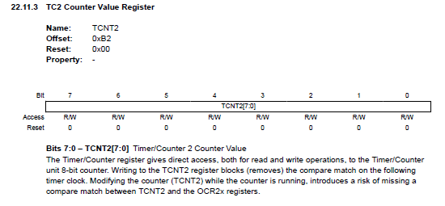
Example Setting Up a timer – loop()
My timer2 is now set to normal operation with 256 prescale value.
I need figure out the time it take for the TCNT2 register to go from 0-255 (8-bit register)
OSC Frequency =16 MHz
Register size= 256 (0-255)
Prescale =256
CLK= 0.0625MHz or 62500 Hz
TimePerTick=1/CLK=0.016ms
TCNT20-255time=RegisterSize*(TimePerTick)
=RegisterSize*(1/CLK)
=256*(1/62500)s=
4.096 ms

Slide 36

Example Setting Up a timer – loop()
My Timer2 TCNT2 register takes 4.096ms to fill (0-255).
I need the LED to toggle every 250ms.
To do this TCNT2 will need to fill and be reset n amount of times.
n= TargetTime/TCNT2Time = 250/4.096=61.04 or ~61 times.
Repeated 61 times
250ms=
4.096ms

Slide 37
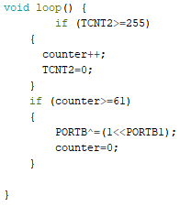
Example Setting Up a timer – loop()

Slide 38
Things to search
Datasheets, datasheets, and datasheets.
The AVR header files
https://github.com/vancegroup-mirrors/avr-libc/blob/master/avr-libc/include/avr/io.h
https://github.com/vancegroup-mirrors/avr-libc/blob/master/avr-libc/include/avr/iom328p.h
Google AVR programming, there's a lot of resources.

Slide 39
TinkerCAD
https://www.tinkercad.com/things/77Zwf8IIOz1

Slide 40

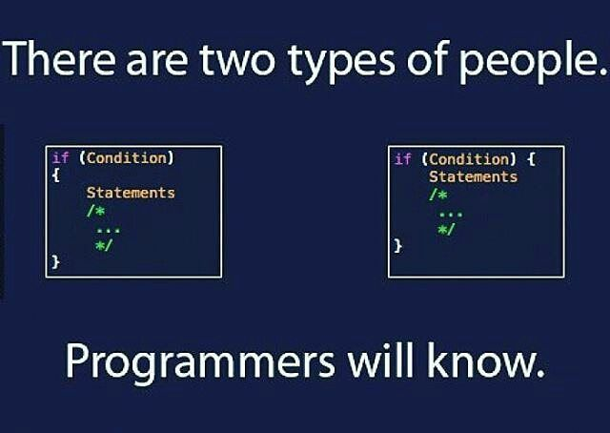
Consider how to program in a group setting
During Group work, consider how to effectively share code between each member:
Modular code (Separate operations into interchangeable functions)
Comment and layout code clearly
Use version control services such as Github or bitbucket

Slide 41
Exercises
Read through the Exercise tasks.
Download the exercise files from UTS online
Determine the relevant modules and operation needed.
Read datasheet for the register.
Code away

Slide 42
Exercise 1
There is an LED on the Arduino board, it is built into the board and is controlled by Digital Pin 13. (Not the ATMEGA328 pin)
Write a program that can turn on this LED and then modify it to turn off the LED.
Which Port is connected to the LED?
Remember you will need to set a data direction which ever port you choose (refer to datasheet on data direction registers)

Slide 43
Exercise 2
Write a program that pulses the LED at 1 Hz
You will need to configure an onboard timer to trigger at 1 Hz (1 second on and 1 second off)
What is the frequency of the onboard oscillator clock? (Big silver oval, ?? MHz)
Refer to Datasheet on how to configure the Timer module.
You will need to configure two control registers and check the counter value register.

Slide 44

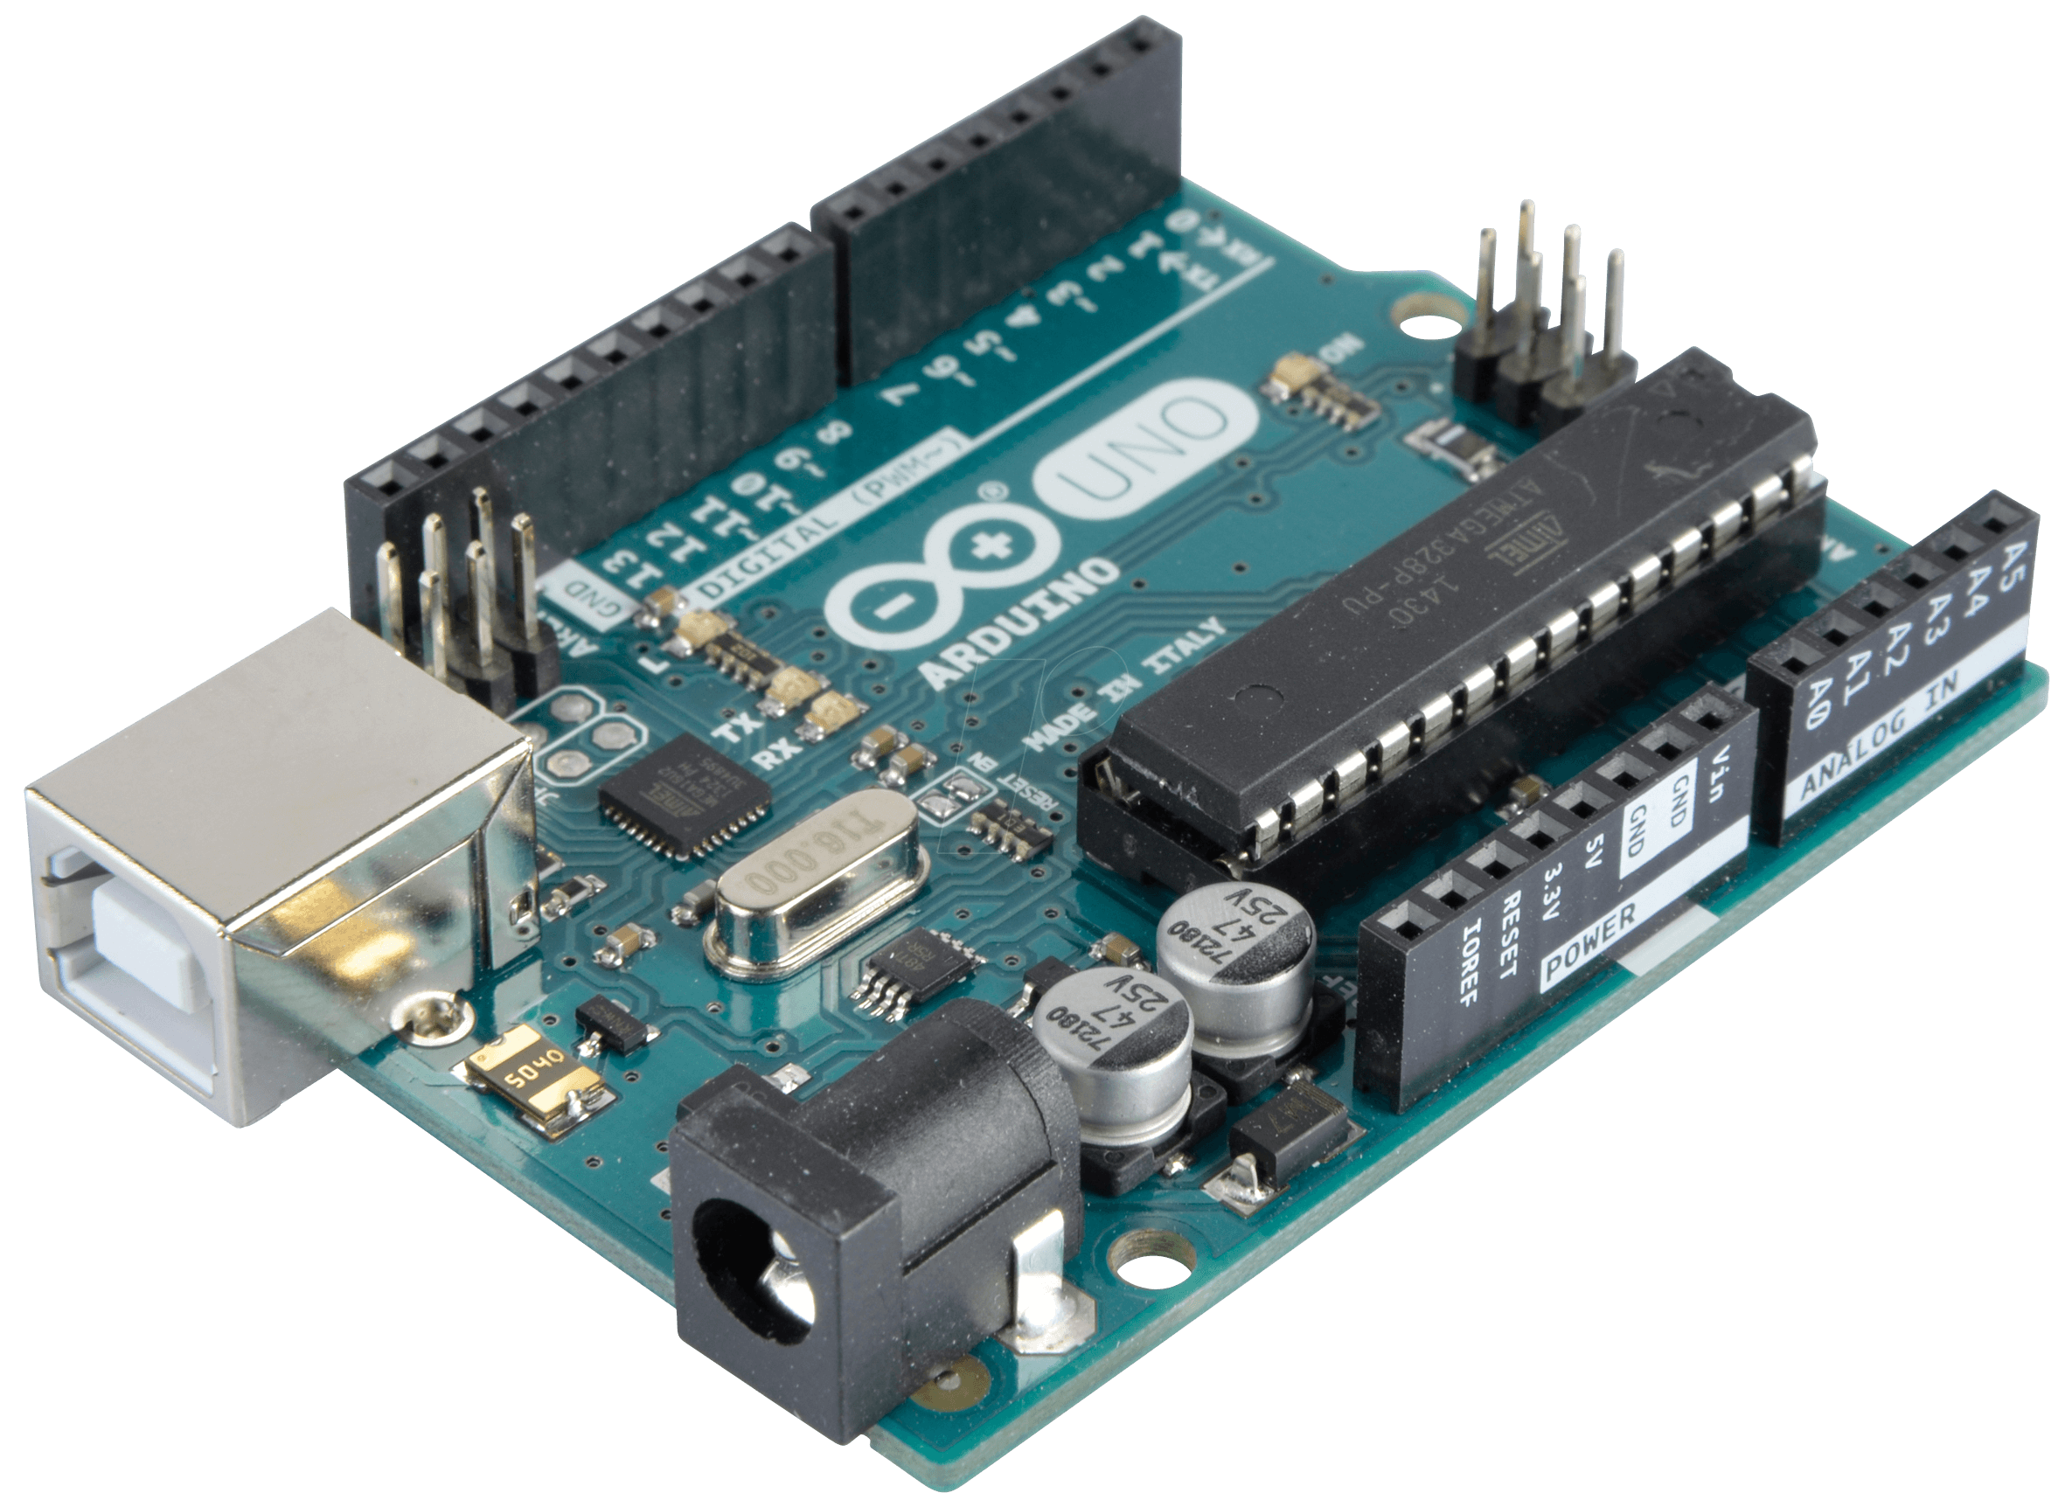
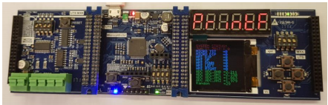
See ya next week!

Slide 45
Exercise 2 Cheat sheet
The simplest way is to set the Timer to operate in normal mode which is the default mode.
This will mean you have to set all non prescaler bits to 0 and set the prescaler to the value you intend to use.
The flowchart(Next slide) outlines the logic for checking if 1 second is reach based on timer cycles.
It is not the code for the program but the logic behind the program.

Slide 46
